Slide 1

Gokaraju Rangaraju Institute of Engineering and Technology (Autonomous) Department of Data Science Mini Project Work (CSE(DS))
Presented by:
1. B. Karthikeya (22241A6771)
2. B. Abhilash Reddy (22241A6775)
3. B. Sushanth (22241A6776)
Under the Guidance of:
Dr. R.P. Ram Kumar
Professor
CSE(DS) Department

Slide 2
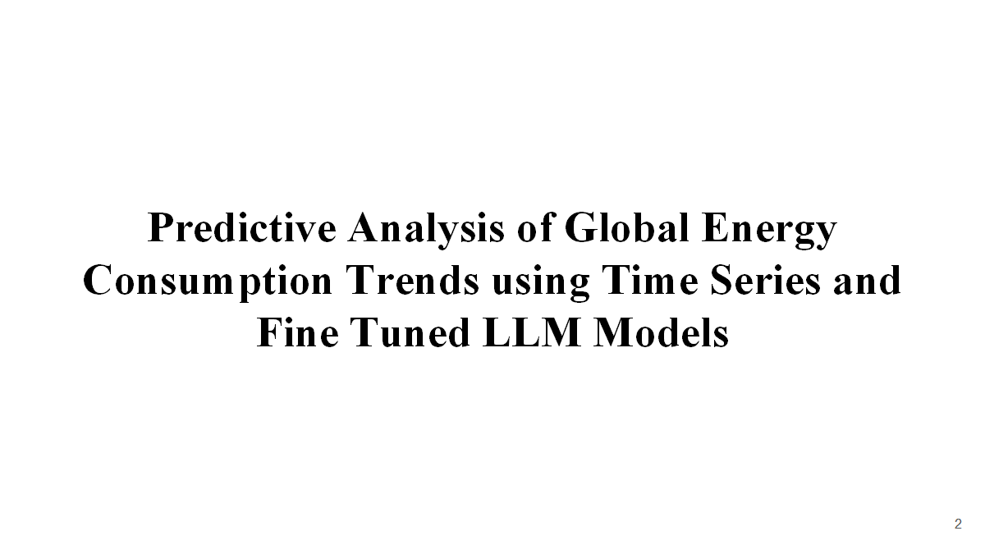

Slide 3
Abstract
The use of non-renewable energy resources, such as coal, oil, and natural gas, significantly impacts nature by causing air and water pollution, climate change, habitat destruction, soil degradation, and resource depletion. These activities release greenhouse gases and toxins, disrupt ecosystems, and reduce biodiversity, so understanding these trends is crucial. This Project focuses on a Comprehensive analysis of Global Energy Trends and their consumption every year using “Time series analysis and Fine-tuned LLM models” by incorporating enhanced prediction and analysis of Global Energy Consumption from Natural Resources like Coal, Oil, Natural Gas. This Project leverages Time Series Analysis (ARIMA, SARIMA) and Fine-Tuned Large Language Models (LLMs) like Mistral, Llama to analyze and predict global energy consumption trends, using historical energy data from sources like Our World in Data (Stanford University), BP Statistical Review, the project identifies key consumption patterns across Coal, Oil, Natural gas to support informed decision-making for Environmental Sustainability
3

Slide 4
Problem Statement
For efficient energy management and policy making, it is essential to accurately forecast changes in global energy use. The complex, non-linear patterns of energy use are frequently difficult for traditional forecasting techniques to capture. By integrating historical data and several contributing factors, this research seeks to improve energy consumption projections through the use of time series analysis and refined Large Language Models (LLMs). The objective is to create a more accurate and dependable model that will help policymakers and energy providers around the world make well-informed decisions.
4

Slide 5
Research Gaps
Data Quality and Availability: Many studies rely on limited or incomplete datasets, which may not capture the full range of factors affecting energy consumption.
Complexity of Hybrid Models: Combining multiple forecasting models can lead to overly complex systems that are difficult to deploy and maintain in real-world scenarios.
Data Dependency: Deep learning models require large amounts of high-quality data for training, which may not always be available in every setting.
Data Consistency: Real-world data on energy consumption can be inconsistent, which affects the performance of machine learning models.
5

Slide 6
Research Gaps
Model Complexity: LSTM models, while powerful, are computationally expensive and require significant resources, making them challenging for real-time applications.
Long-Term Prediction: The models used face uncertainty in projecting long-term energy consumption impacts due to the unpredictability of future climate scenarios.
Overfitting: Short-term models, such as LSTM and GRU, are prone to overfitting when trained on limited data, reducing their generalizability to new or unseen scenarios.
Integration with Real-World Systems: The proposed models may not integrate easily into existing building management systems, making practical implementation challenging.
6

Slide 7
Objectives
To Develop a predictive model for global energy consumption trends using time series analysis and fine-tuned Large Language Models (LLMs).
To Integrate multiple data sources including historical energy consumption data, socio-economic factors, and environmental variables to improve model accuracy.
To Evaluate the performance of the proposed model by comparing it with traditional energy forecasting techniques in terms of accuracy and efficiency.
To Identify key factors influencing global energy consumption patterns and integrate them into the predictive framework.
To Provide actionable insights for energy policymakers and businesses to better manage energy resources and anticipate future demand.
7

Slide 8
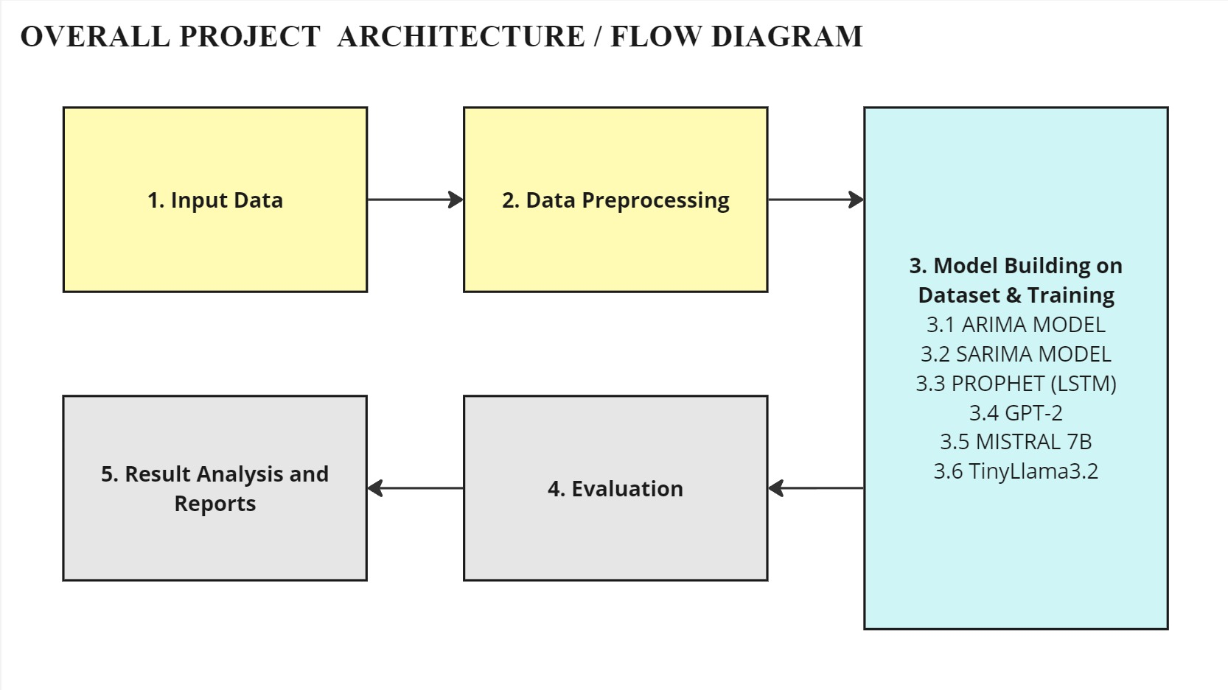
8

Slide 9
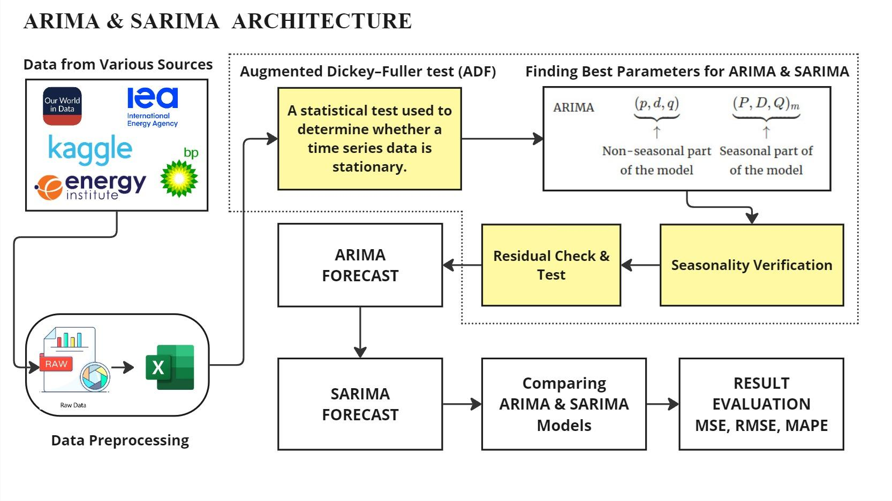
9

Slide 10
Description of Architecture Diagram
The above figure shows an eight-step process for working with time series data using ARIMA and SARIMA models through different steps, from testing the data to evaluating predictions in a clear, structured way. We start with the Augmented Dickey-Fuller (ADF) test to see if the data is steady and consistent over time like checking if the data is stationary meaning its statistical properties, like mean and variance, stay consistent over time. Stationarity is crucial for models like ARIMA and SARIMA to work effectively, as they rely on predictable patterns. If the ADF test shows the data if the data is not stationary (e.g., it has trends or changing variance), we will need to transform it often by differencing before modelling. Essentially, the ADF test helps ensure your data is ready for accurate forecasting by confirming it doesn’t have unstable shifts. Stationarity transformation methods other stationarity tests; if not, we adjust it by differencing. Then, we tweak ARIMA by picking the best (p, d, q) parameters which defines the choosing how much past data, smoothing, and error to factor in and for SARIMA, we add seasonal settings (P, D, Q, m) to capture patterns that repeat, like yearly cycles.

Slide 11
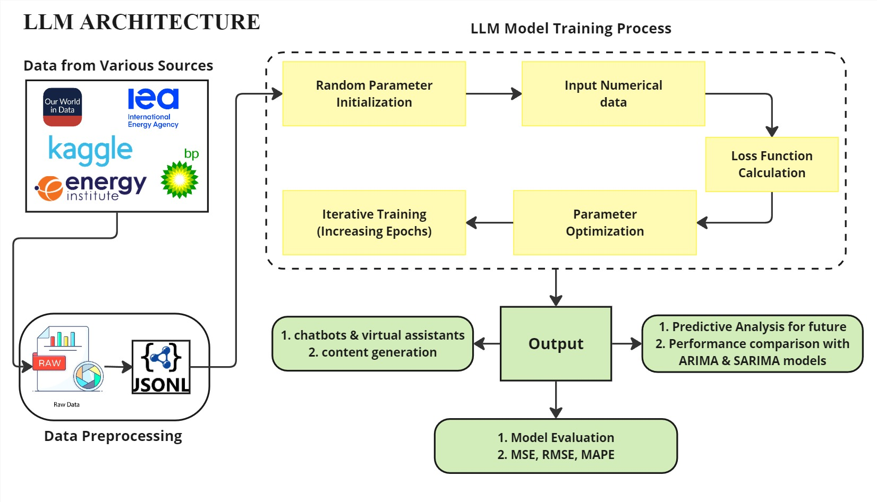
11

Slide 12
Description of Architecture Diagram
The above figure shows a four-step workflow for training and using a large language model (LLM) to analyse numerical data, generate outputs, and make predictions, guiding from model training to evaluation in a structured sequence. The process starts with the model training process, where the basic LLM starts with random weights with no prior knowledge, we perform predictions with this basic LLM with no initial knowledge about the dataset. We then fine-tune the model with structured numerical data, after fine-tuning with several techniques like Lora and QLora, the model is now ready to predict the data, comparing them to the real data to see how the model is performing and measure the loss. Then, we further re fine-tune the model with increased epochs, improving its settings to lower the loss, learning from its mistakes, and repeats this cycle (called epochs) to get better each time. Once trained, the model moves to output generation, where it can able to generate summaries and numerical predictions, or even power a chatbot to answer energy-related questions

Slide 13
Software and Hardware Requirements
SOFTWARE | HARDWARE
Operating System: Windows 10/11, macOS, or Linux (Ubuntu preferred) Programming Languages: Python (preferred), R (optional for statistical modeling) Libraries & Frameworks: Time Series Analysis: statsmodels, prophet (LSTM) Machine Learning: tensorflow, torch Data Processing: pandas, numpy, matplotlib LLM Fine-Tuning & Inference: transformers, bitsAndBytes, accelerate | CPU: Intel Core i7/i9 (12th Gen or later) or AMD Ryzen 7/9 (5000 series or later) RAM: Minimum 16GB GPU: NVIDIA RTX 3090/4090, T4 GPU (for fine-tuning LLMs) Cloud GPU Access: Google Colab (Inference), Kaggle (Training Model) Storage: SSD (Minimum 1TB) Network: High-speed internet (for cloud-based LLM training & data fetching)
13

Slide 14
Datasets Details
1. Coal Consumption Dataset
https://ourworldindata.org/grapher/coal-consumption-by-country-terawatt-hours-twh
2. Natural Gas Consumption Dataset
https://ourworldindata.org/grapher/natural-gas-consumption-by-region
3. Oil Consumption Dataset
https://ourworldindata.org/grapher/oil-consumption-by-country
Size of the Datasets: 5522 rows Each including 73 Countries and 31 Regions.
Attributes:
Entity: Categorical attribute (Country or Region).
Year: Numerical attribute (Integer, representing the year).
Consumption (TWh): Numerical attribute (Floating point, representing energy consumption in TWh).
Sources: Statistical Review of World Energy, Our World in Data.
14

Slide 15
Implementation Details
1. Code Style: Adhere to PEP 8
Follow PEP 8 guidelines: use 4 spaces for indentation, limit lines to 79 characters (or 120 if agreed), use snake_case for variables/functions, and add spaces around operators.
Use formatters like black and linters like flake8 to enforce consistent style.
2. Jupyter Notebook Best Practices
Start notebooks with a markdown cell explaining their purpose.
Use markdown headings to organize sections like data loading, model training, and evaluation.
Keep code cells short, focusing on one task per cell.
List all dependencies at the top in a dedicated cell for imports and installations.
Name notebooks descriptively to reflect their purpose.
3. Version Control: Git Best Practices
Write clear, descriptive commit messages detailing changes made.
Work on feature branches instead of directly on master, merging via pull requests.

Slide 16
Add sensitive or large files (e.g., .env, datasets) to .gitignore.
Set up pre-commit hooks to catch issues like secrets or notebook outputs before committing.
4. Documentation: Comment and Explain
Add comments or markdown cells to explain complex logic, especially for model training and evaluation.
Document fine-tuning steps for LLMs and parameter choices for ARIMA/SARIMA.
Use markdown cells to describe the purpose of each notebook section.
5. Reproducibility: Ensure Code Runs Anywhere
Create a requirements.txt file to list all dependencies for easy setup.
Set random seeds for reproducibility in models like LLMs.
Provide instructions in a README.md for accessing external datasets, avoiding committing large data files to Git.
6. Error Handling and Logging
Implement error handling for API calls and model training to catch and manage failures.
Use the logging module instead of print statements for debugging and tracking execution.
Log key steps like data loading, model training, and evaluation to aid troubleshooting.

Slide 17
Test Cases
Test 1. Time Series Preparation
Convert World data to time series with Year as index.
Run stationarity test on World data, log results.
Perform seasonal decomposition on Africa data.
Test 2. Model Training (ARIMA/SARIMA)
Train ARIMA on , log summary stats.
Train SARIMA on data, confirm seasonal fit.
Test ARIMA/SARIMA with invalid parameters, verify error handling.
Test 3. Model Training (LLMs)
Prepare Coal consumption data for LLM input (text sequence).
Fine-tune Tiny LLaMa 1.1B on data, log loss.

Slide 18
Test 4. Forecasting
Forecast China 2024–2028 with ARIMA, ensure positive values.
Forecast Africa 2024–2028 with SARIMA, check seasonal patterns.
Forecast India 2024 with Mistral 7B, ensure reasonable output.
Test 5. Model Evaluation
Split World data: train (1965–2018), test (2019–2023).
Evaluate ARIMA on United States test data, log MSE/RMSE/MAPE.
Test 6. Performance
Train ARIMA on World data, ensure completion < 10 seconds.
Train SARIMA on data, verify success.

Slide 19
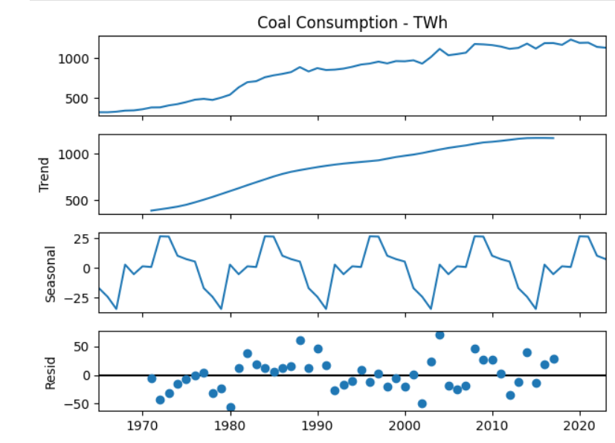
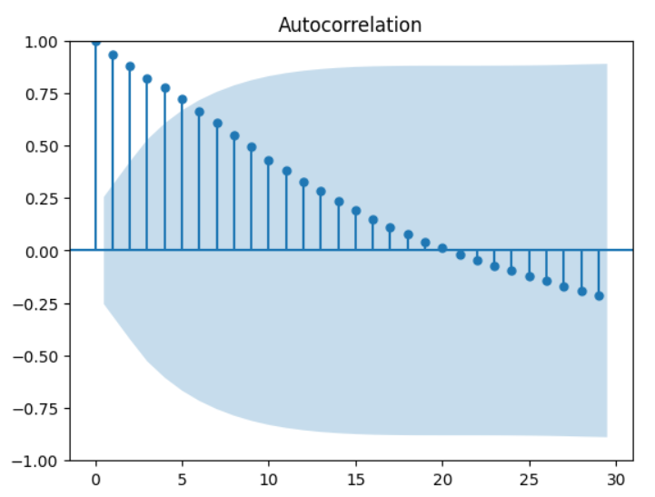
Screenshots of Results

Slide 20
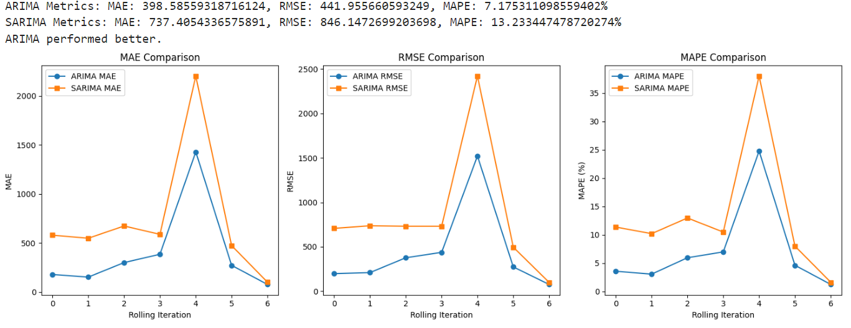

Slide 21
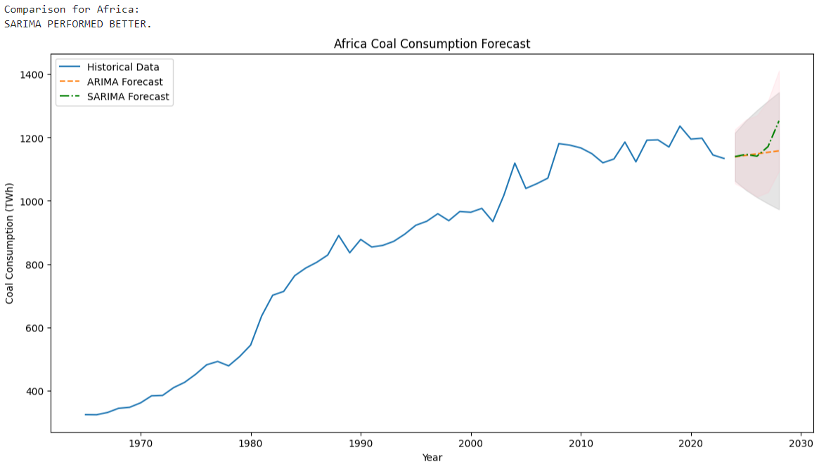

Slide 22
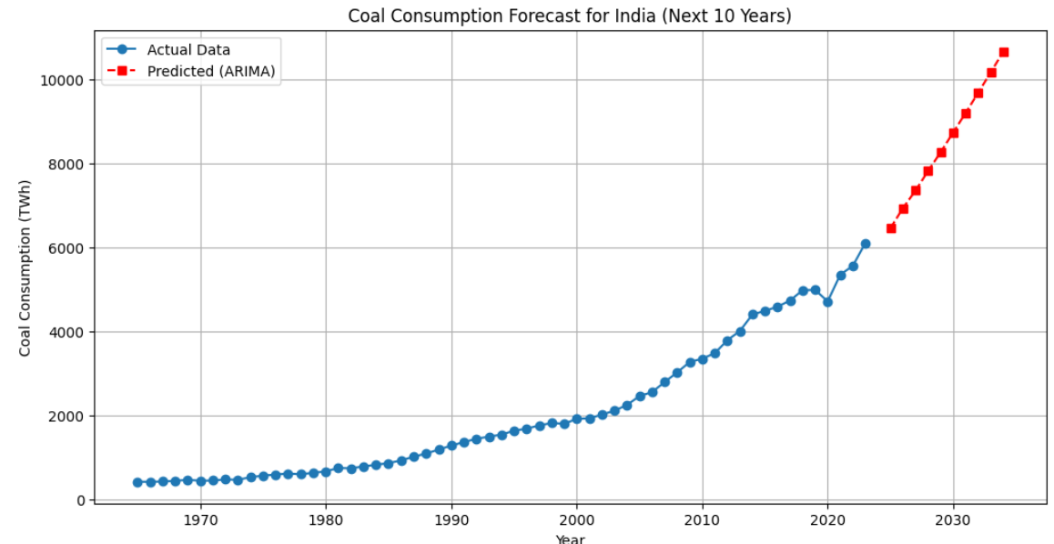
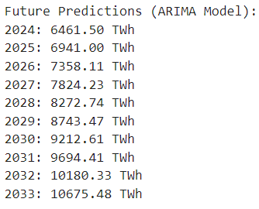

Slide 23
Conclusion
We hereby conclude that this project demonstrates the powerful synergy between traditional statistical models and modern AI techniques for analyzing global energy consumption. By combining Time Series models (ARIMA, SARIMA) with Fine-Tuned Large Language Models (LLMs) like Mistral and Llama, we were able to capture complex patterns and trends in the consumption of non-renewable resources such as coal, oil, and natural gas. The results show how AI-driven forecasting can complement classical approaches, offering more adaptive and accurate predictions that are essential for today’s rapidly changing energy data. The integration of historical datasets with advanced modeling allows for deeper insights into how energy usage evolves over time and supports the development of smarter, sustainability-focused policies. Ultimately, this project not only provides a robust framework for forecasting global energy trends but also reinforces the critical role of data-driven approaches in addressing environmental challenges and guiding strategic decision-making toward a more sustainable future.

Slide 24
Future Enhancements
Real-Time Forecasting Dashboard:
Create an interactive web dashboard (using Streamlit or Dash) where users can choose a country and instantly view forecasts, charts, and model comparisons.
Support for Additional Forecasting Models:
Add models like Facebook Prophet (already hinted at), LSTM, XGBoost, or hybrid models to broaden forecasting capabilities and improve accuracy.
Model Auto-Tuning and Benchmarking:
Integrate automated hyperparameter tuning tools (e.g. GridSearch) to fine-tune ARIMA/SARIMA and LLM prompts for better performance.

Slide 25
Natural Language Interaction Layer:
Let users interact with the system using natural language (e.g., “What will the temperature in Spain be next month?”), with the LLM parsing the intent.
Explainability and Visualization Tools:
Adding Tableau or PowerBI or other explainability libraries to give users insights into why a model made a certain prediction.

Slide 26
Thank you
26

